Slide 1

McGraw-Hill Technology Education
Copyright © 2006 by The McGraw-Hill Companies, Inc. All rights reserved.

Slide 2
Chapter 3A
Using the Keyboard And Mouse

Slide 3
The Keyboard
The most common input device
  Must be proficient with keyboard
  Skill is called keyboarding

Slide 4
The Keyboard
How keyboard works
  Keyboard controller detects a key press
  Controller sends a code to the CPU
    Code represents the key pressed
  Controller notifies the operating system
  Operating system responds
  Controller repeats the letter if held
Notes:
Teaching tip
Table 5A.3 presents the ASCII code. An exercise that never fails to amuse students is to use the Alt and the number pad to enter letters into an application. As before, open MS Word. Have students hold down the Alt key and type an ASCII value into the number pad. Once they release the Alt, the letter appears. This is a useful skill when the keyboard breaks. Challenge the students to explore numbers above 128.

Slide 5
The Mouse
All modern computers have a variant
Allows users to select objects
  Pointer moved by the mouse
Mechanical mouse
  Rubber ball determines direction and speed
  The ball often requires cleaning

Slide 6
The Mouse
Optical mouse
  Light shown onto mouse pad
  Reflection determines speed and direction
  Requires little maintenance

Slide 7
The Mouse
Interacting with a mouse
  Actions involve pointing to an object
  Clicking selects the object
  Clicking and holding drags the object
  Releasing an object is a drop
  Right clicking activates the shortcut menu
  Modern mice include a scroll wheel
Notes:
Insider information
Douglas Englebart patented the first mouse in 1970 as the “X-Y position indicator for a display system.” The name mouse comes from the tail on the device.

Slide 8
The Mouse
Benefits
  Pointer positioning is fast
  Menu interaction is easy
  Users can draw electronically

Slide 9
The Mouse
Mouse button configuration
  Configured for a right-handed user
    Can be reconfigured
  Between 1 and 6 buttons
  Extra buttons are configurable

Slide 10
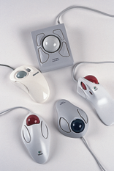
Variants of the Mouse
Trackballs
  Upside down mouse
  Hand rests on the ball
  User moves the ball
  Uses little desk space

Slide 11
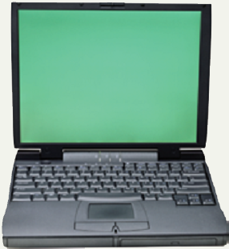
Variants of the Mouse
Track pads
  Stationary pointing device
  Small plastic rectangle
  Finger moves across the pad
  Pointer moves with the pointer
  Popular on laptops

Slide 12
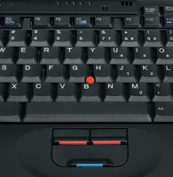
Variants of the Mouse
Track point
  Little joystick on the keyboard
  Move pointer by moving the joystick
Notes:
Insider information
The term track point is copyrighted by IBM.

Slide 13
Ergonomics and Input Devices
Ergonomics
  Study of human and tool interaction
  Concerned with physical interaction
  Attempts to improve safety and comfort

Slide 14
Ergonomics and Input Devices
Repetitive Strain Injury (RSI)
  Caused by continuous misuse of the body
  Many professions suffer from RSI
Carpal Tunnel Syndrome
  Carpal tunnel is a passage in the wrist
  Holds nerves and tendons
  Prolonged keyboarding swells tendons
Notes:
Teaching tip
Hairstylists often suffer from carpal tunnel. Bicyclists can suffer from overuse injuries of the knee.
Page 116 of the text has a diagram of the carpal tunnel.

Slide 15
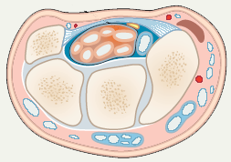
Carpal Tunnel Syndrome

Slide 16
Ergonomics and Input Devices
Office hardware suggestions
  Office chairs should have
    Adjustable armrests and height
    Armrests
    Lower back support
  Desks should have
    Have a keyboard tray
    Keep hands at keyboard height
    Place the monitor at eye level

Slide 17
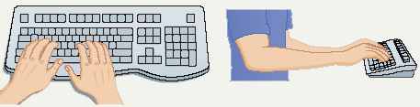
Ergonomics and Input Devices
Techniques to avoid RSI
  Sit up straight
  Have a padded wrist support
  Keep your arms straight
  Keyboard properly
  Take frequent breaks

Slide 18
Chapter 3A
End of Chapter

